Slide 1
Idle Reduction for Light- and
Medium-Duty Fleets
Notes:
Thank introducer, hosting organization (if not yours), and audience.
_______________________________________________________
⃝ = Notes for presenter.
↘↘↘ = More detailed/background information for the presenter (may be of interest to some audiences or useful in response to some questions) and sources.
_______________________________________________________
⃝ Presenter: This is an overview presentation with optional, additional slides on technology solutions and IdleBox set after the final slide. In this first slide, you may choose to place your organization’s logo in the bubble to the upper right of the Clean Cities logo. Modify the presentation to accommodate variations in time allotted and anticipated audience interests and knowledge level. At the presentation event, consider distributing some of these IdleBox materials:
The tip sheet (https://cleancities.energy.gov/files/pdfs/idlebox_tip_sheet.pdf)
Stickers (downloaded and printed from https://cleancities.energy.gov/files/images/idlebox_sticker.jpg or ordered from NREL for Clean Cities coordinators)
Bookmarks (https://cleancities.energy.gov/files/docs/template_idle_free_cards.doc)
Fact cards/bookmarks (https://cleancities.energy.gov/files/pdfs/idle_free_cards.pdf)
Fact sheet “Idling Reduction for Personal Vehicles” (https://afdc.energy.gov/files/u/publication/idling_personal_vehicles.pdf)
Fact sheet “Idling Reduction for Emergency and Other Service Vehicles” (https://afdc.energy.gov/files/u/publication/idling_emergency-service_vehicles.pdf)
The idling savings calculator (https://www.anl.gov/es/reference/vehicle-idle-reduction-savings-worksheet-pdf)
Technology solutions table (https://www.anl.gov/es/reference/idling-reduction-technology-solutions-for-class-18-vehicles)

Slide 2
Idle Reduction for Light- and Medium-Duty Fleets
What Is Idling?
What Vehicles Idle?
Most Idling Is Wasteful
Some Idling Can Be Harder to Avoid
Why Care About Idling?
What You Can Do
Resources
Notes:
In this presentation, I’ll cover the basics of idle reduction, from why drivers idle to ways to reduce or even eliminate it.
What Is Idling?
What Vehicles Idle?
Most Idling Is Wasteful
Some Idling Can Be Harder to Avoid
Why Care About Idling?
What You Can Do
Resources
Shutterstock 770738398

Slide 3
[Add a slide about your coalition/organization as appropriate]
Notes:
Before I get into the nuts and bolts of the presentation, let me tell you briefly about [my organization].

Slide 4
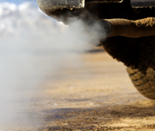
What is Idling?
When a vehicle’s engine is running for nonpropulsion purposes, it is idling.
Examples:
Drivers waiting to pick up passengers
Trucks idling while in queue
Vehicles waiting to load/unload passengers or goods, including:
  Delivery trucks
  Shuttle buses
  Taxis
Notes:
First, let’s define idling. Idling is running a vehicle engine for nonpropulsion purposes. Some examples are shown on the slide.
While this definition is generally good, it suggests that the solution is to just turn the key. That’s sometimes true—as in the case of idling out of habit—but it’s more complicated than that.
Shutterstock 68649247

Slide 5
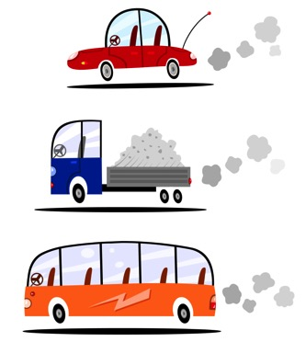
What Vehicles Idle?
Light duty
Passenger vehicles, including cars, SUVs, police cruisers, some light trucks, etc.
Medium duty
Utility vehicles, delivery trucks, shuttle buses, ambulances, etc.
Heavy duty
Long-haul trucks, tour buses, school buses, etc.
Notes:
What vehicles idle? Pretty much any vehicle can, from light duty to heavy duty, including nonroad vehicles such as construction and agricultural equipment, locomotives, water-borne vessels, and aircraft. The focus of this presentation is light- and medium-duty vehicles.
Shutterstock 68649247

Slide 6

Most Idling Is Wasteful
Engine/cabin warming
All vehicle types (today’s vehicles warm up faster by being driven than by idling – see manufacturer guidance)
Waiting
Taxis, delivery trucks, utility trucks, transit buses, shuttle buses, and personal vehicles
Vehicle as an office
During lunch breaks, to complete paperwork, to make phone calls
Notes:
Each year, U.S. passenger vehicles, light trucks, medium-duty trucks, and heavy-duty vehicles consume more than 6 billion gallons of diesel fuel and gasoline combined—without even moving. Unnecessary idling often occurs:
With idling to “warm up” the engine and the misuse of remote starters
Waiting during the course of pickup and deliveries—of not only goods, but people—and utility trucks waiting to do work
When drivers use their vehicle as an office, especially in comfortable weather when climate control is not needed
Unnecessary idling may also occur:
In convenience store parking lots (when someone “runs in” for coffee)
At drive-throughs where stops last minutes rather than seconds (pharmacies and banks)
While waiting at long freight-train crossings or bridge lifts
Some drivers may feel uncomfortable turning their engines on and off frequently. What if my vehicle doesn’t restart? Won’t I wear out my starter? With today’s advanced vehicle technologies, these worries no longer apply.
↘↘↘ See “Which Is Greener: Idle, or Stop and Restart? Comparing Fuel Use and Emissions for Short Passenger-Car Stops” https://afdc.energy.gov/files/u/publication/which_is_greener.pdf
Shutterstock 567109810 (delivery truck) and Shutterstock 54776782 (taxis)

Slide 7

Some Idling Can Be Harder to Avoid
Running emergency lights and other auxiliaries
Emergency vehicles, utility vehicles
Powering HVAC and/or temperature control for passengers or cargo
All vehicle types for operator and passenger comfort in extreme weather
Performing non-propulsion work
Bucket trucks, sewer-line maintenance trucks, woodchippers
Notes:
Sometimes, idling can be hard to avoid, such as when there’s a need for stationary power. There are solutions, but there’s no one-size-fits-all solution. Power needs vary.
Emergency vehicles need power to run lights and other auxiliaries like communications equipment.
All vehicle types need HVAC for the driver and any passengers when temperatures are very low or high. Sometimes cargo requires controlled temperatures (e.g., refrigerated trucks).
Utility vehicles are usually designed to do stationary work, for which they need power. These vehicles are often equipped with “power take-off” or PTO, which transfers energy from the running engine to another device that does the work.
Knowing the “why” of idling is important for evaluating potential solutions. Optimal solutions for delivery trucks will likely be different than those for work trucks.
Shutterstock 108854660 (police) and Shutterstock 90630583 (utility truck)

Slide 8
Why Care About Idling?
While many individual episodes are small, the cumulative impacts of idling are large.
Notes:
While a single vehicle may generate a relatively small amount of emissions and wasted fuel, these individual episodes accumulate. For a fleet of 10, 50, or 100 vehicles, the cumulative impacts can be significant.
Passenger cars—which are light-duty vehicles—are a substantial source of idling emissions and wasted fuel. Imagine this: if each car in the United States idles just 6 minutes per day, about 3 billion gallons of fuel are wasted annually, costing drivers $7.5 billion (if gas is $2.50/gal)—and they haven’t gotten anywhere!
↘↘↘ = ~275 million vehicles in the U.S. in 2017 (https://www.fhwa.dot.gov/policyinformation/statistics/2017/mv1.cfm)
Image: Argonne National Laboratory

Slide 9
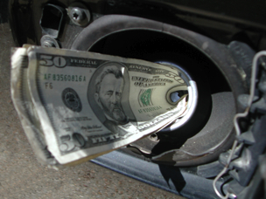
Why Care About Idling?
Idling Is Expensive
Notes:
I’m going to give you some specifics on the cost of idling.
Shutterstock 248599

Slide 10
Idling is Expensive
Idling a car wastes from 0.2 to 0.5 gallons of fuel per hour.
Idling a medium-duty truck wastes 0.4 to 0.6 gallons of fuel per hour.
Idling in the U.S. uses more than 6 billion gallons of fuel at a cost of more than $15 billion each year.
Idling can increase vehicle maintenance costs.
Idling can shorten engine life.
Notes:
Idling a car wastes from 0.2 to 0.5 gallons of fuel per hour, depending on what accessories, such as HVAC, the driver’s running.
Idling a medium-duty truck wastes about half a gallon of fuel per hour.
Engine idling can increase vehicle maintenance costs and shorten engine life.
Idling in the U.S. uses more than 6 billion gallons of fuel at a cost of more than $15 billion each year.
↘↘↘ $15 billion when fuel is $2.50/gallon, $18 billion when fuel is $3.00/gallon.
As you can see, idling has a lot of costs—from the costs of wasted fuel to increased maintenance required. For many trucks, maintenance intervals are set by engine hours rather than miles driven. Idling counts as engine hours.

Slide 11

Idling Is Expensive
Scenario: Fleet of 10 medium-duty delivery trucks
If each truck has ten 10-minute idling episodes per workday and uses ~0.5 gallons/hour, and fuel costs $2.50/gallon, the annual cost of 0-mpg fuel for the fleet is ~$5,460.
Notes:
Here’s a scenario for what idling might cost a fleet of 10 medium-duty trucks when fuel is $2.50/gallon. Fuel burned during idling would cost the fleet more than $5,000 annually
↘↘↘ Breakdown of “fuel is $2.50/gal scenario”
One truck idling 100 minutes (1.6 hours) per day consumes ~0.83 gallons of fuel daily.
~0.83 gallons means a daily fuel cost of $2.10 for one truck.
For a 260-workday year, the annual cost of one truck’s idled fuel is $546; for ten trucks, $5,460.
When fuel is $4.00/gallon, the annual cost of idled fuel increases to $8,630 for this fleet of 10 vehicles.

Slide 12

Why Care About Idling?
Idling Pollutes.
Notes:
Engine idling pollutes the air.
Shutterstock 12004621

Slide 13

Idling Pollutes
U.S.: ~28% of greenhouse gas emissions come from transportation.
Each gallon of fuel burned produces about 20 pounds of carbon dioxide, a greenhouse gas.
Vehicle emissions contribute to the formation of ground-level ozone.
Poor air quality can have economic impacts.
Notes:
Here are the key pollution and climate-related impacts of idling.
Nationally, about 28% of greenhouse gas emissions come from transportation.
↘↘↘ https://www.epa.gov/ghgemissions/sources-greenhouse-gas-emissions
Each gallon of fuel burned produces about 20 pounds of carbon dioxide, a greenhouse gas that contributes to climate change.
Motor vehicle emissions contribute to the formation of ground-level ozone, which damages air quality.
↘↘↘ Ozone is a “secondary pollutant” caused by emitted nitrogen oxides (NOx, pronounced “knocks”) and volatile organic compounds (VOCs, pronounced “vocks”) in the presence of sunlight.
↘↘↘ In addition to nitrogen oxides, idling vehicles emit carbon monoxide (CO), sulphur oxides, and particulates (PM10 and PM2.5).
Poor air quality can have direct and indirect economic impacts. Cities or regions out of compliance—called “nonattainment”—with the U.S. Environmental Agency’s National Ambient Air Quality Standards (NAAQS, pronounced “Knacks”) may be seen as less attractive for potential economic development than locations in attainment.
↘↘↘ NAAQS regulate six “criteria pollutants,” These include ozone, particulate matter, nitrogen oxides, sulfur oxides, carbon monoxide, and lead.
These issues have led to many jurisdictions to pass laws restricting idling.
Shutterstock 388630477

Slide 14
Why Care About Idling?
Idling Threatens Health
Notes:
All of these emissions mean health impacts.
Shutterstock 777404392

Slide 15
Idling Threatens Health
The most immediate health impacts from transportation stem from tailpipe emissions.
Particulate Matter
Irritates the eyes, nose, throat, and lungs, contributing to respiratory and cardiovascular illnesses
Ground-level Ozone
Can inflame and damage the airways and aggravate diseases such as asthma, emphysema, and chronic bronchitis
Notes:
Tailpipe emissions can have real-time health impacts.
Particulate matter irritates the eyes, nose, throat, and lungs, contributing to respiratory and cardiovascular illnesses.
↘↘↘ Health Effects of Particulate Matter, https://www.epa.gov/pm-pollution/health-and-environmental-effects-particulate-matter-pm
Ground-level ozone can inflame and damage the airways and aggravate a number of diseases.
↘↘↘ Health Effects of Ozone Pollution, https://www.epa.gov/ground-level-ozone-pollution/health-effects-ozone-pollution
Environmental justice communities, which are usually located in areas with the worst air quality, are disproportionately impacted by pollution and its health effects.
↘↘↘ Environmental justice is the concept of giving all populations the same degree of protection from environmental and health hazards and equal access to decision-making processes that affect where they live, learn, and work. https://www.epa.gov/environmentaljustice

Slide 16
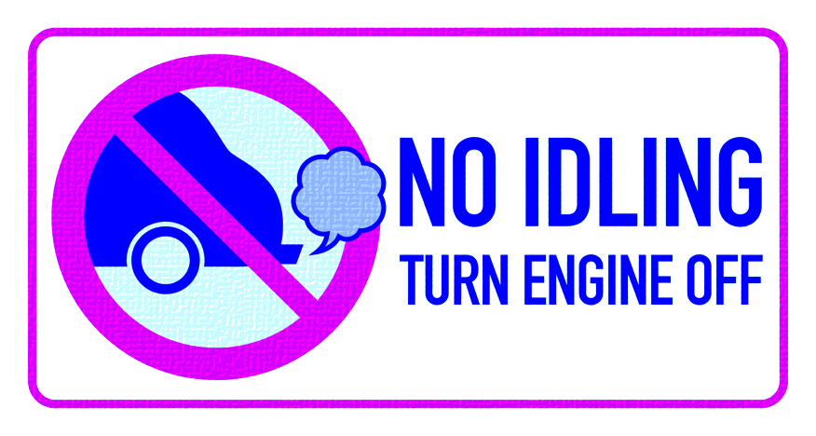
Why Care About Idling?
Laws and Fines
Notes:
You may or may not know that idling is against the law in a number of states, counties, and cities.
Shutterstock 46999250

Slide 17
Laws and Fines
Notes:
Here’s an overview of idling laws in the U.S. The states in orange have statewide idling laws, and the states in blue have idling laws at the county, city, or village level. The states in gray have no known idling laws. While most idling laws pertain to diesel-fueled vehicles, some apply to gasoline-fueled vehicles, too.
In states that have a statewide law, there may be stricter idling laws at the local level.

Slide 18
Laws and Fines: (Fill in City/State Name)
Presenter provides info specific to city/state/regional laws or deletes slide.
Notes:
⃝ Presenter: If your region has no such laws, you’ll want to delete this slide. If you need information about laws in your region, please see IdleBox’s database, IdleBase, at https://cleancities.energy.gov/files/docs/idlebox_idlebase_database.xlsx.

Slide 19
What You Can Do
Three Steps to Reduce Idling
Notes:
I’m going to describe three steps you can take to achieve and benefit from idle reduction.

Slide 20
Step 1: Commit
Devise a policy to reduce unnecessary idling.
For vehicles that need stationary power, consider idle reduction technology to provide necessary services.
Notes:
Now that you’re aware of the benefits of idle reduction, the first step is to commit to action. Plan to devise an idle reduction policy for your fleet.
An idle reduction policy states when the engine should be shut off. A policy might state, for example, that vehicles may idle for no longer than 3 minutes if not in traffic. The policy will also describe exemptions, such as, “Unless the outside temperature is above X or below Y.
↘↘↘ Fleet managers decide on the degree of monitoring and enforcement they want. Some fleets decide that the carrot works better than the stick and focus on offering incentives or rewards for logging low idle times (rather than consequences for noncompliance).
↘↘↘ Telematics systems monitor many aspects of vehicle use, including idling.
If vehicles need stationary power regularly, consider idle reduction technologies to provide necessary services.
⃝ Presenter: A table of technology solutions and an idling savings calculator are described on optional slides at the end of the slide deck.
Shutterstock 45208684

Slide 21
Step 2: Engage and Educate Your Drivers
Host an educational event on idle reduction
Introduce and explain the reasons for the new idling policy
Ask drivers to make a pledge to reduce idling
Reinforce the idle reduction message regularly
  Signs and posters
  Dashboard stickers
  Employee communications
Offer incentives/rewards/recognition to drivers who successfully reduce idling
Notes:
Educate your drivers about idle reduction. Driver education can take many forms, including workshops, meetings, or on-line trainings.
↘↘↘ Training on “eco-driving” can include tips for improving fuel efficiency, including reducing aggressive acceleration and braking in addition to idling.
Introduce the new idling policy. Consider asking drivers to make a pledge to reduce idling and reinforce the policy through various employee communications.
↘↘↘ The IdleBox toolkit has materials to help fleets with this.
If possible, offer incentives, rewards, and/or recognition for drivers who successfully reduce idling.
↘↘↘ This is sometimes called “gamification.”

Slide 22
Step 3: Consider Technology
Options to support your idle reduction efforts
  Engine idle management systems
  Heaters
  Cooling
  Auxiliary power systems (including power take-off)
  Other solutions such as stop-start technology
Notes:
A number of off-the-shelf technologies support idle reduction if vehicles aren’t already equipped. Be aware that there is no one-size-fits all solution. Solutions depend on the particular services needed while the vehicle is stationary.
The slide shows the types of systems available. They range from simple systems that shut a vehicle’s engine off after X number of minutes to devices that provide long-term power and/or heat and cooling.

Slide 23
Resources and Potential Funding Assistance
State grant programs
  EPA’s State Clean Diesel Grant Program
National grant programs
  EPA’s Diesel Emissions Reduction Program (DERA)
  VW Settlement funds (Eligible Mitigation Option 10, DERA)
Programs targeted to assisting small businesses, improving air quality, sustainability initiatives, etc.

Slide 24
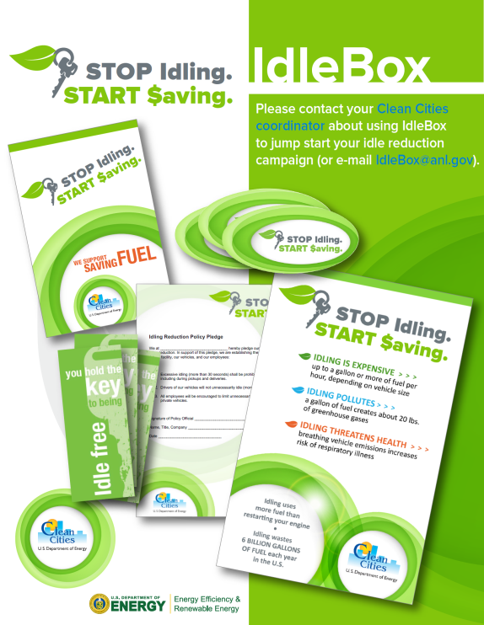
IdleBox: A Clean Cities’ Resource
Fact sheets, fact cards, and stickers
An outdoor sign template and poster templates
Pledge forms and policy templates
Idle reduction cost savings calculator
Table of technology solutions with manufacturer links
IdleBase: A database of idling regulations
https://cleancities.energy.gov/technical-assistance/idlebox/
Notes:
⃝ Presenter, if you don’t want to direct your audience to access IdleBox directly, delete this slide. If you want to go into more depth on IdleBox, see some of the optional slides at the end of the slide deck.
IdleBox is a free, online resource.
↘↘↘ The idle reduction team at Argonne National Laboratory developed this flexible, data-based idle-reduction toolbox for U.S. DOE’s Clean Cities initiative.
This slide shows just some of the tools available through the IdleBox website. Most are customizable. Content can be modified to suit your organization, and your own logo can be added.
You can find IdleBox quickly by Googling “IdleBox” or by going to the web address shown on the slide.

Slide 25
Idle Reduction for Light- and
Medium-Duty Fleets
Thank You
Notes:
This wraps up my presentation. I’d like to leave you with a couple of thoughts. Idle reduction is often called the “low-hanging fruit of fuel economy.” Unlike some other fuel-economy and emissions-reduction undertakings that require significant research and investment, reducing idling is something almost any driver can do beginning today, with real-time reductions in fuel use and emissions. Even equipment solutions will pay for themselves over time.

Slide 26
Optional Slides
Notes:
⃝ Presenter: Slides 27-31 describe technology solutions. Slides 32-35 show key IdleBox tools.

Slide 27
Engine Idle Management Systems
Idle Timer
Turns engine off after a preset amount of idle time
Automatic Engine Shut-Down/Start-Up System
Cycles engine on and off as needed to maintain cabin temperature while maintaining battery state-of-charge
Notes:
Engine idle management systems fall into two general categories.
Idle timers, also called “idle limiters,” simply shut off a vehicle’s engine after a preset amount of idle time (e.g., 3 minutes).
Automatic engine shut-down/start-up systems shut down a vehicle’s engine and restart it when the temperature inside the vehicle exceeds a lower or upper limit (to power HVAC) or when battery power falls below a certain threshold (to recharge the battery).

Slide 28
Heaters
Fuel-operated heater
For a range of vehicle types, including electric and alternative-fuel buses
Coolant heater
Can recirculate the engine’s “waste heat” after the engine is turned off
Other systems are integrated into the engine coolant circuit; may include a heat exchanger or a small recirculating pump to provide heat to cabin while engine is off
Engine preheater
Heats engine block, oil, and/or coolant; can be on a timer to eliminate “warm-up” idling for diesel vehicles
If coolant is heated, may serve as coolant heater to warm cabin
Notes:
Some systems provide heat for the vehicle occupants or for the engine block.
Vehicle operators who need heat for the cab or passenger compartment might consider air heaters. These units use much less fuel than does engine idling. Heaters come in a number of forms:
Fuel-fired heaters are sometimes called “direct-fired heaters” or “cabin heaters.”
Coolant heaters use fuel to heat engine coolant, which is then circulated to keep the operator cabin warm.
Waste-heat recovery systems circulate coolant warmed by engine operation to provide heat to the operator cabin when the engine is off.
Engine-block heaters simply preheat the engine block (or keep it warm). For some diesel engines in cold weather, a warmed engine block eliminates the need for prolonged, “warm up” idling.

Slide 29
Cooling
Auxiliary Air Conditioner
Usually part of a full auxiliary power system
Evaporative Cooler
Hot, dry environments

Slide 30
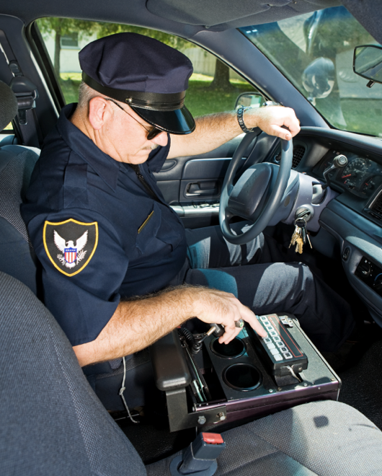
Auxiliary Power Systems
Auxiliary power is provided for:
  Communications, electronics
  Emergency lighting
  Heat and A/C
  Other devices, including “power take-off” (PTO) equipment for work trucks
Usually battery-electric powered for light- and medium-duty vehicles.
Notes:
Auxiliary power systems are the most comprehensive solution and, for vehicles that idle a lot for climate control and power, they’re a good solution.
Auxiliary power systems provide power for HVAC, electronics, and other devices. Some systems provide power for power take-off (PTO) equipment for work trucks.
↘↘↘ PTOs divert power from the main vehicle engine to power another device, such as a hydraulic lift.
The auxiliary power systems, which may run on diesel fuel or battery, are often called “auxiliary power units” (APUs). Systems powered or supplemented by other means, such as fuel cells or solar power, are also possible.
A number of police departments use either automatic stop-start controls with a battery-charge monitor or auxiliary batteries, which run vehicle warning lights and communication systems while the engine is off. Use of these technologies can significantly reduce idling times, which means decreased fuel use and engine wear.

Slide 31
Other Solutions
Idle stop-start technology, hybrid vehicles, or full electric vehicles, which don’t idle
Telematics for identifying opportunities— including idle reduction—for increased operational efficiency
Notes:
Stop-start technology, which increasingly comes installed on vehicles, automatically shuts off the main engine at stops and seamlessly restarts it when the driver releases the brake. For urban drive cycles with lots of stop-and-go driving, this technology can save a lot of fuel.
↘↘↘ Stop-start technology is sometimes called idle-stop or microhybrid technology.
Telematics combines telecommunications and informatics technologies for the collection, transmission—and increasingly, analysis—of information about vehicles and their operations. Among the data telematics collects is information about the ”who,” “where,” and “for how long” on idling episodes. Data can be examined at the driver or vehicle level and at the aggregate level for a big-picture view fleet idling losses.

Slide 32
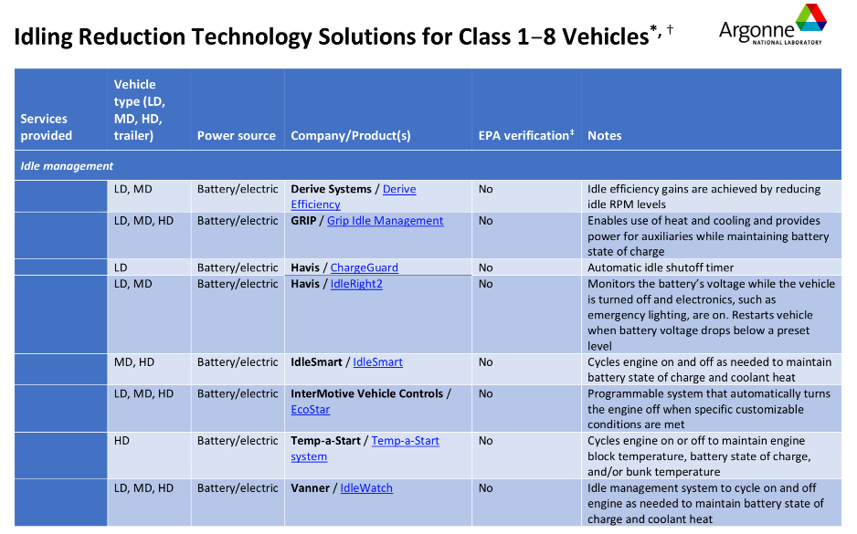
Idle Reduction Equipment Reference
Organized by service(s) needed:
  Idle management
  Heat only
  Cooling only
  Heat, cooling, and power (auxiliary power unit)
  Power take-off
  Cargo refrigeration
  Wayside power / truck stop electrification
https://www.anl.gov/es/reference/idling-reduction-technology-solutions-for-class-18-vehicles
Notes:
Idling Reduction Technology Solutions for Class 1-8 Vehicles is a table of about 45 idle reduction technologies with basic information and direct links to the manufacturer web pages.
This table is organized by stationary services needed (such as heat, cooling, or both with the addition of power). The second column indicates for which general vehicle classes—light duty, medium duty, or heavy duty—the solutions apply.
This resource can be found in IdleBox. You can also find it by Googling the title.
⃝ Presenter: You can go directly to the table from the hyperlink on the slide.

Slide 33
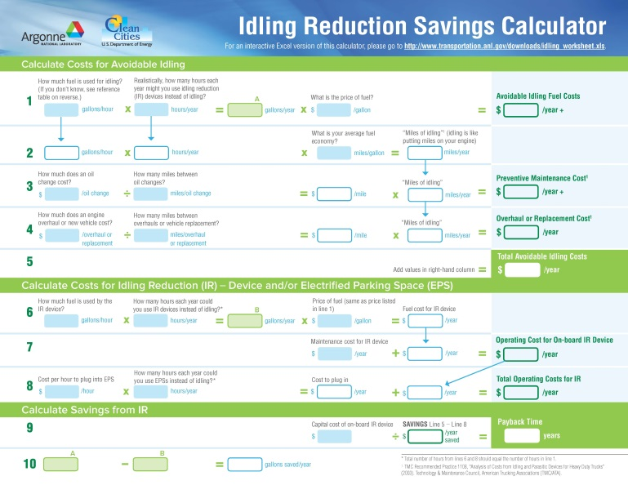
Idle Reduction Savings Calculator
The Idle Reduction Savings Calculator helps fleet managers and others estimate how much they can save by using idle reduction technologies.
https://www.anl.gov/es/reference/vehicle-idle-reduction-savings-worksheet-pdf
Notes:
The cost-effectiveness of any idle reduction approach or technology depends on the amount of idling to be offset, which depends in part on the climate where it will be used.
Argonne National Laboratory provides this Idle Reduction Savings Calculator that allows fleet managers, owner-operators, and others to determine how much money they can save with idle reduction.
Depending on the technology chosen, current fuel prices, and how much a vehicle idles, the payback for idle reduction technology use may be months or years. There’s a lot of variability.
This can be found in IdleBox. You can also find it by Googling the title.
⃝ Presenter: You can go directly to the landing page for the calculator from the hyperlink on the slide.

Slide 34
Idle Reduction Savings Calculator, cont.
The calculator includes ballpark idling fuel-use assumptions for various vehicle types.
Notes:
The calculator includes some ballpark idling fuel-use assumptions in case you don’t have the information at hand.
Another Argonne tool, AFLEET, which stands for “Alternative Fuel Life-Cycle Environmental and Economic Transportation Tool,” incorporates idle reduction into its calculations. Let me know if you’d like more information on AFLEET.
↘↘↘ https://greet.es.anl.gov/afleet_tool

Slide 35
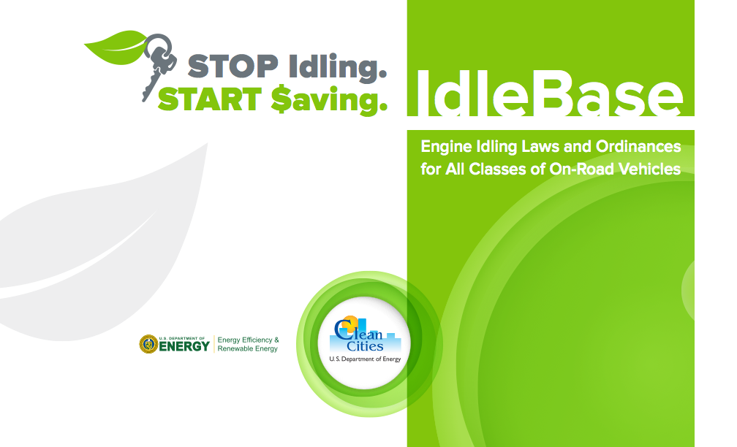
IdleBase: A Database of Idling Regulations
cleancities.energy.gov/idlebase
Notes:
Clean Cities’ IdleBase is a compilation of idling laws for all classes of on-road vehicles. Organized by state, it describes vehicle type, exemptions to the law, and penalties known, with links to the law itself.
IdleBase can be found in IdleBox. You can also find it by Googling “IdleBase.”
⃝ Presenter: You can go directly to the landing page for IdleBase from the hyperlink on the slide.

Slide 36
End of Optional Slides

